Slide 1

University of Luxembourg
Sébastien De Landtsheer
Model Ensembling as a Tool to Form Interpretable Multi-Omic Predictors of Cancer Pharmacosensitivity
October 2022
Progress Report
Systems Biology Group

Slide 2
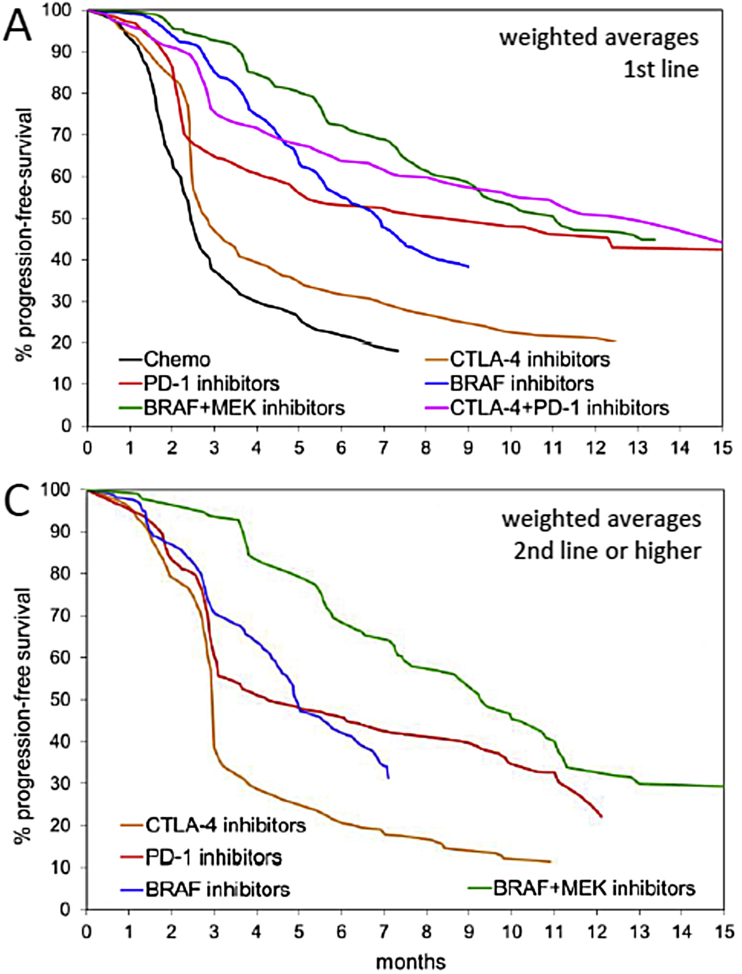
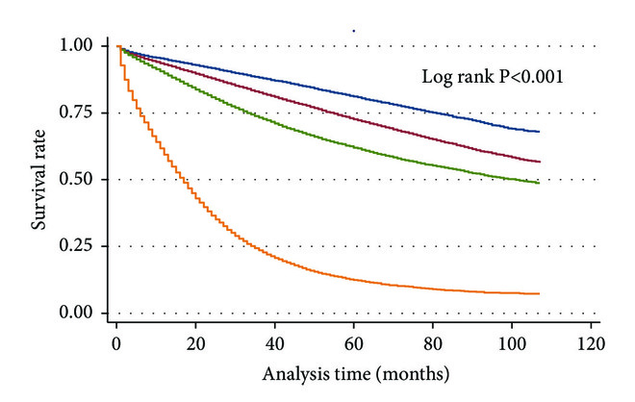
Patient responses to chemotherapies are highly variable
Melanoma
Colon carcinoma
stage I
stage II
stage III
stage IV
Unmet need for improvement of care of cancer patients
Nearly all biomarkers are genomic (BCR-ABL, EGFR, etc.)
Goal: develop predictors of drug response across omic types
Ugurel et al., Eur. J. Cancer (2016), 53; 125-34
Ulanja et al., J. Oncol. (2019):4315032

Slide 3

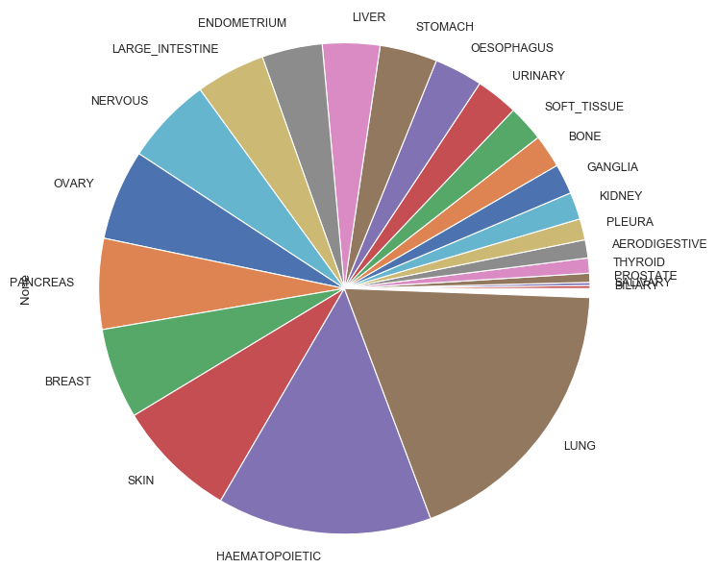
CCLE dataset: a large-scale screening effort provides multi-omic data
1000+ cell lines with near-complete multi-omics:
Genomics / Transcriptomics / Metabolomics / miRNA / RPPA and others
Dose-responses for 23 drugs
Barretina et al., Nature (2012), 483,7391; 603-7
Ghandi et al., Nature (2019), 569,7757; 503-8

Slide 4

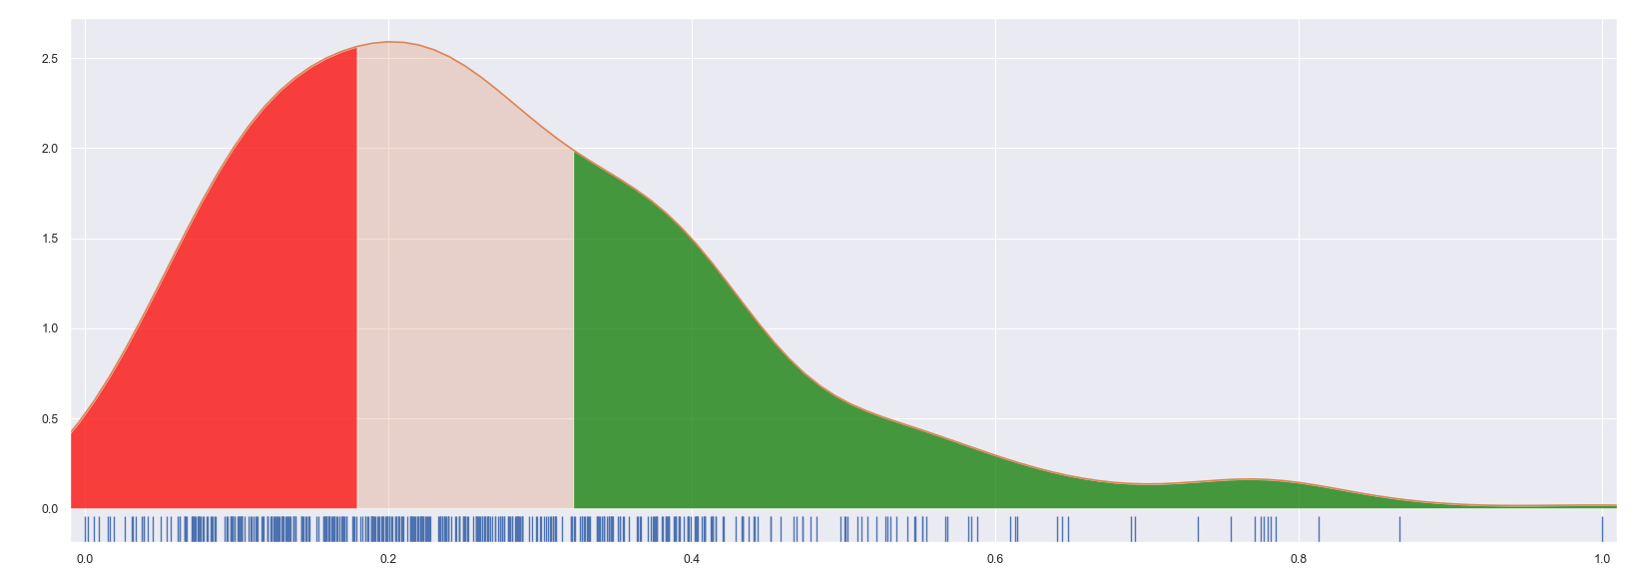
CCLE dataset: Activity Area as a proxy for cell line sensitivity
cell lines
‘Activity Area’ :
Area above the inhibition curve
Advantage vs IC₅₀: takes fractional killing into account
growth
IC₅₀
[inhibitor]
Distribution of normalized ActArea
Removed from analysis
Resistant
Sensitive
1/3 1/3 1/3

Slide 5
Pipeline : Ensemble of omic-specific models and their predictions
Omic Algorithm
Random Forest
Genomic
AdaBoost
Transcriptomic
XGBoost
Metabolomic
Extra-Trees
+
Proteomic
SVM
Pathway Analysis
Logistic
Tumor origin
Ridge
Elastic-Net

Slide 6
Pipeline : Ensemble of omic-specific models and their predictions
Omic Algorithm Prediction
Random Forest
P_{S}(RF)(omic)
Genomic
AdaBoost
P_{S}(Ada)(omic)
Transcriptomic
XGBoost
P_{S}(XGB)(omic)
Metabolomic
Extra-Trees
P_{S}(ET)(omic)
+
Proteomic
SVM
P_{S}(SVM)(omic)
Pathway Analysis
Logistic
P_{S}(Log)(omic)
Tumor origin
Ridge
P_{S}(R)(omic)
Elastic-Net
P_{S}(EN)(omic)

Slide 7
Pipeline : Ensemble of omic-specific models and their predictions
Omic Algorithm Prediction Integration
Random Forest
P_{S}(RF)(omic)
Genomic
AdaBoost
P_{S}(Ada)(omic)
Transcriptomic
XGBoost
P_{S}(XGB)(omic)
Metabolomic
Extra-Trees
P_{S}(ET)(omic)
Meta Classifier (Random Forest)
+
Proteomic
SVM
P_{S}(SVM)(omic)
Pathway Analysis
Logistic
P_{S}(Log)(omic)
Tumor origin
Ridge
P_{S}(R)(omic)
Elastic-Net
P_{S}(EN)(omic)

Slide 8
Validation procedure: nested cross-validation generates predictions for every sample while avoiding data leakage
transcriptomics
genomics
typing
pathways
proteomics
metabolomics
miRNomics
N samples
Current dataset
1) 10% Validation set is excluded

Slide 9
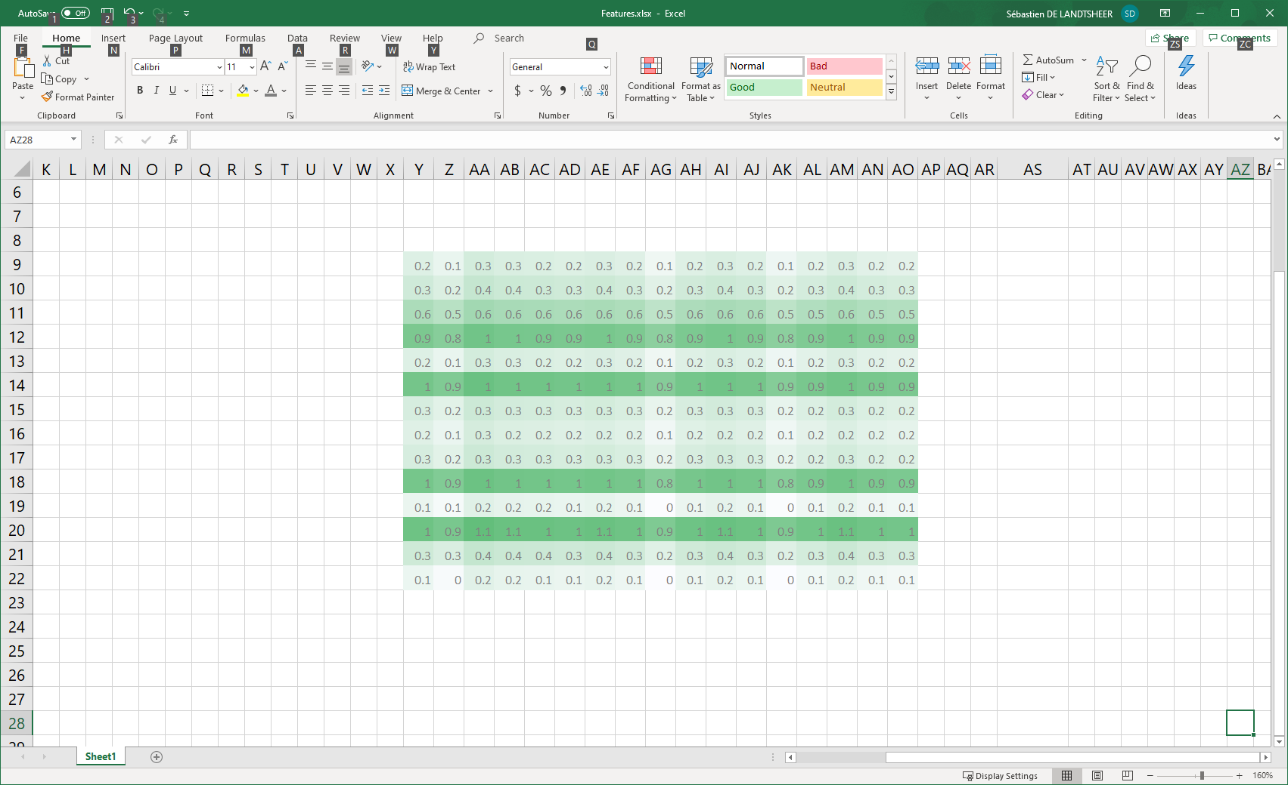
Validation procedure: nested cross-validation generates predictions for every sample while avoiding data leakage
transcriptomics
genomics
typing
pathways
proteomics
metabolomics
miRNomics
N samples
Current dataset
1) 10% Validation set is excluded
transcriptomics – model 1
transcriptomics – model 2
transcriptomics – model 3
genomics – model 1
genomics – model 2
genomics – model 3
typing – model 1
typing – model 2
typing – model 3
pathways – model 1
pathways – model 2
pathways – model 3
…
Repeat 10x
Model A1
Model A3
Model A2
2) 10% test set is excluded
3) each 1st-level model forms a prediction for the excluded test set

Slide 10
Validation procedure: nested cross-validation generates predictions for every sample while avoiding data leakage
transcriptomics
genomics
typing
pathways
proteomics
metabolomics
miRNomics
N samples
Current dataset
1) 10% Validation set is excluded
transcriptomics – model 1
transcriptomics – model 2
transcriptomics – model 3
genomics – model 1
genomics – model 2
genomics – model 3
typing – model 1
typing – model 2
typing – model 3
pathways – model 1
pathways – model 2
pathways – model 3
…
Repeat 10x
Model A1
Model A3
Model A2
2) 10% test set is excluded
3) each 1st-level model forms a prediction for the excluded test set
Repeat 10x
model B1
model B2
model B3
…
TP
4) The 2nd-level model tries to predict the validation set
Meta Model
FP

Slide 11
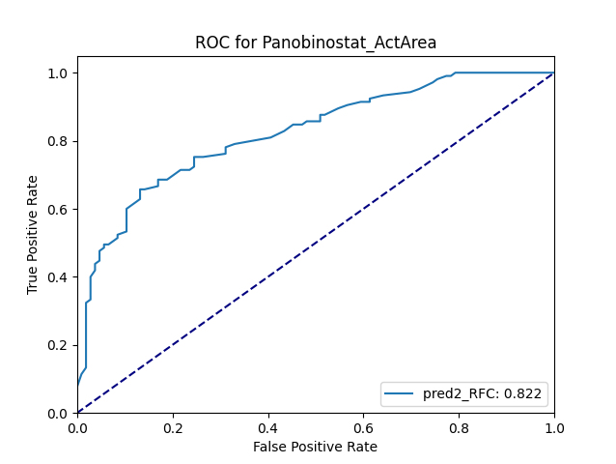
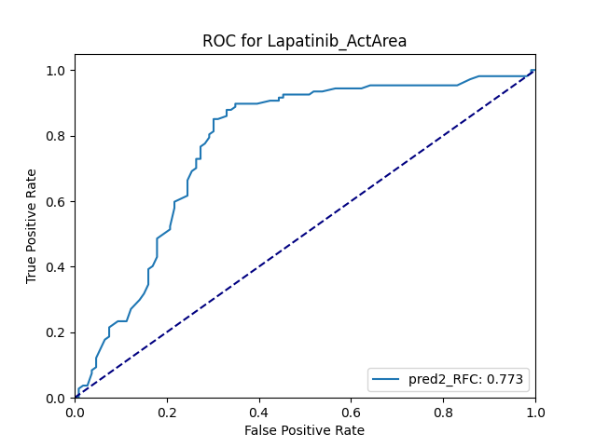

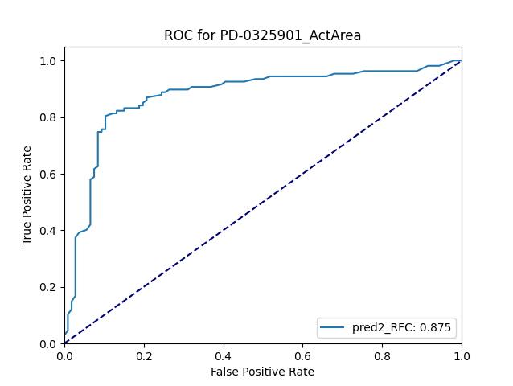
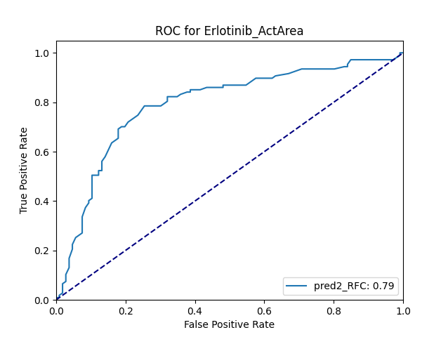
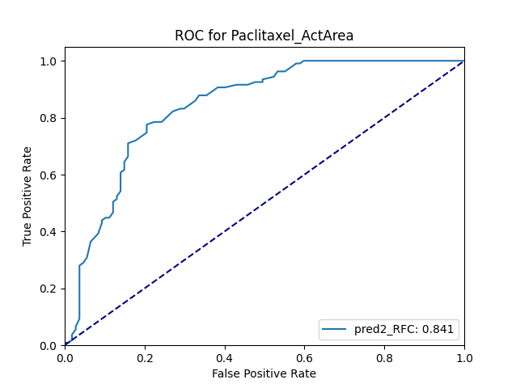
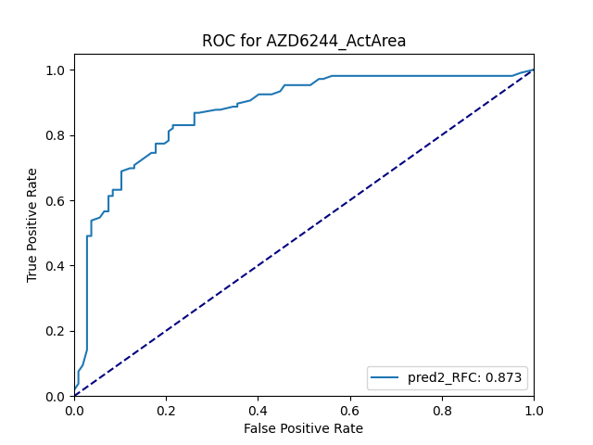
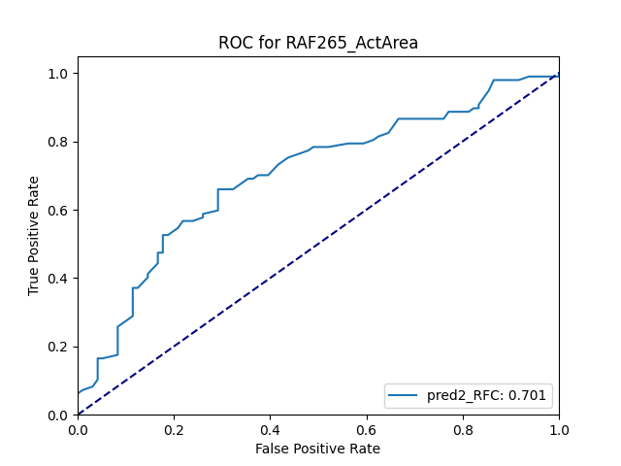
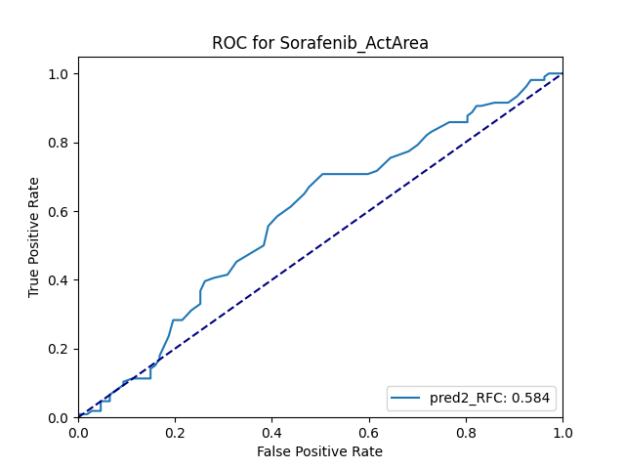

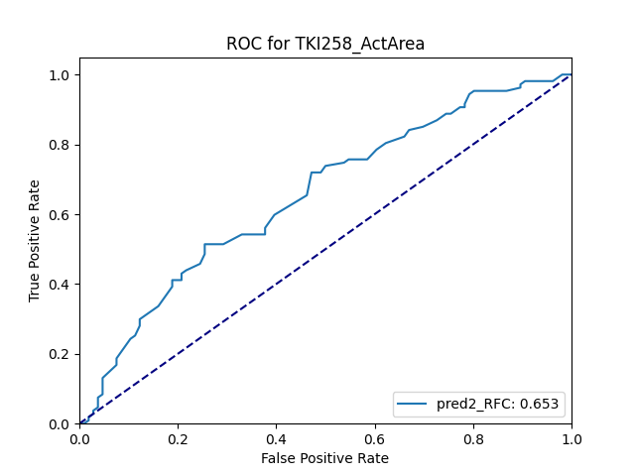

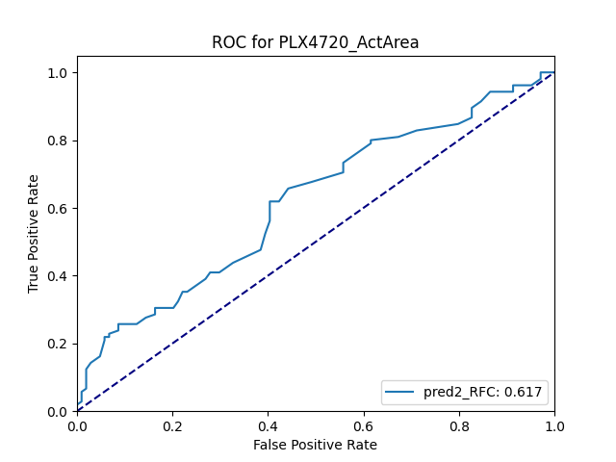
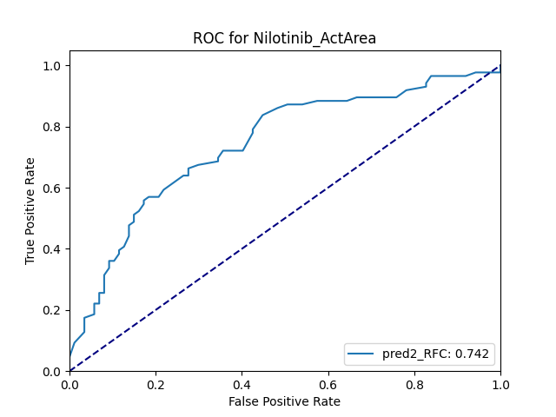
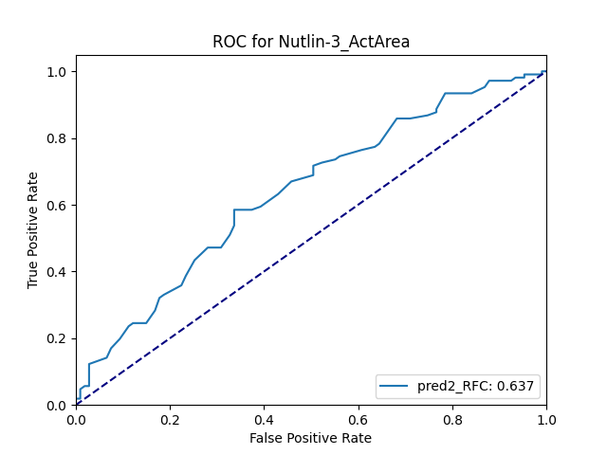
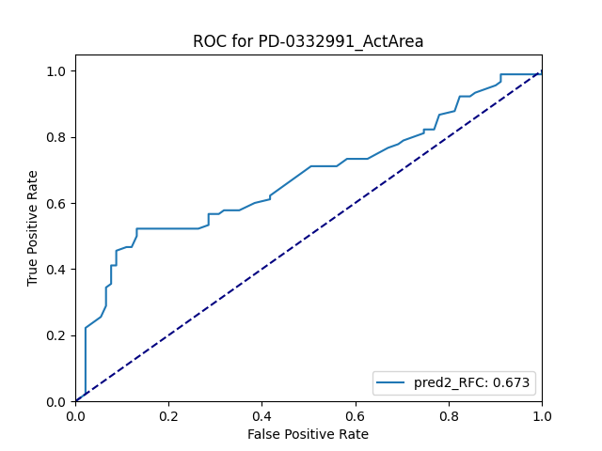
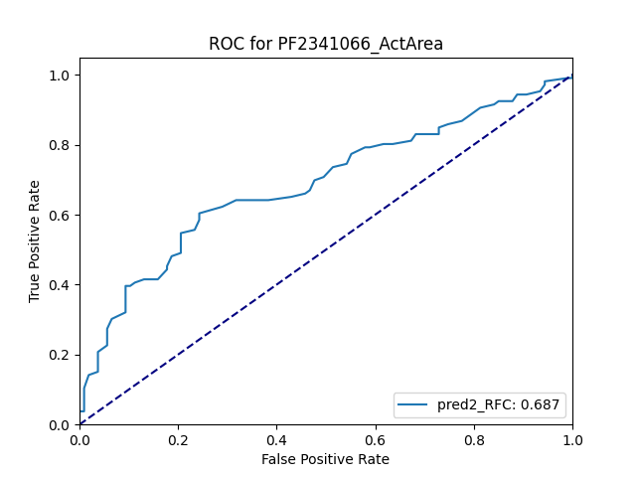
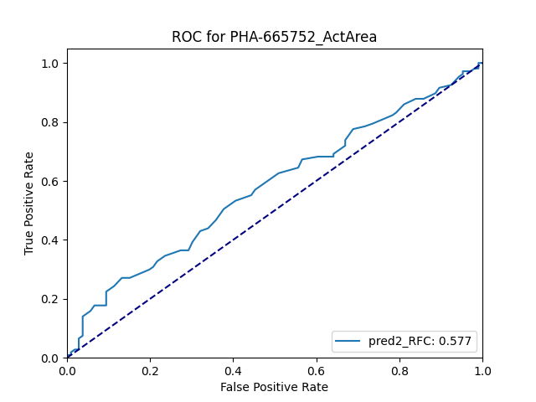
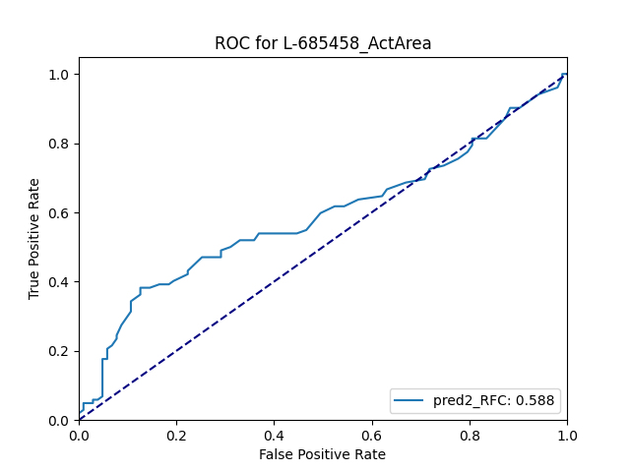
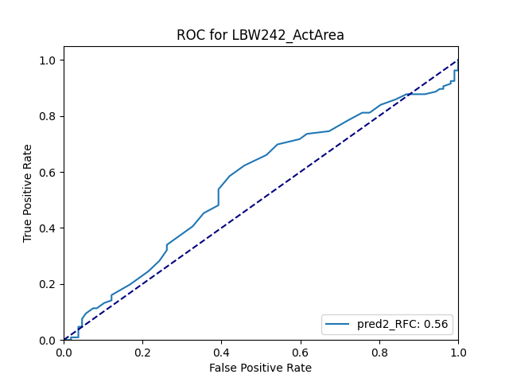

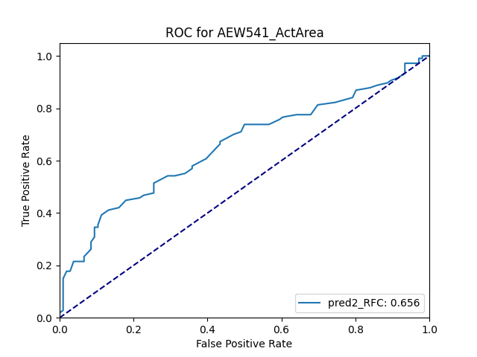

Mixed performance across 23 metaclassifiers

Slide 12
Mixed performance across 23 metaclassifiers

Slide 13
Mixed performance across 23 metaclassifiers

Slide 14
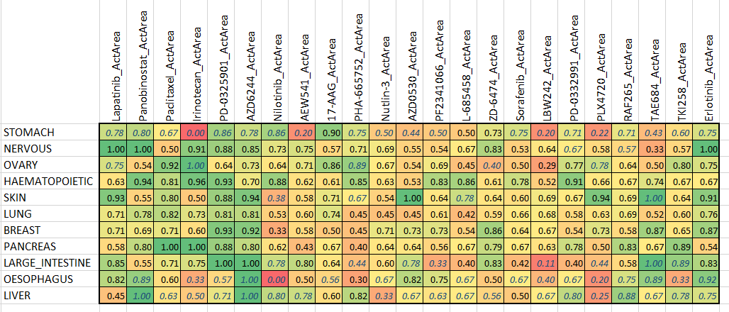
Accuracy varies across cell type and drugs
Italics: N < 10

Slide 15
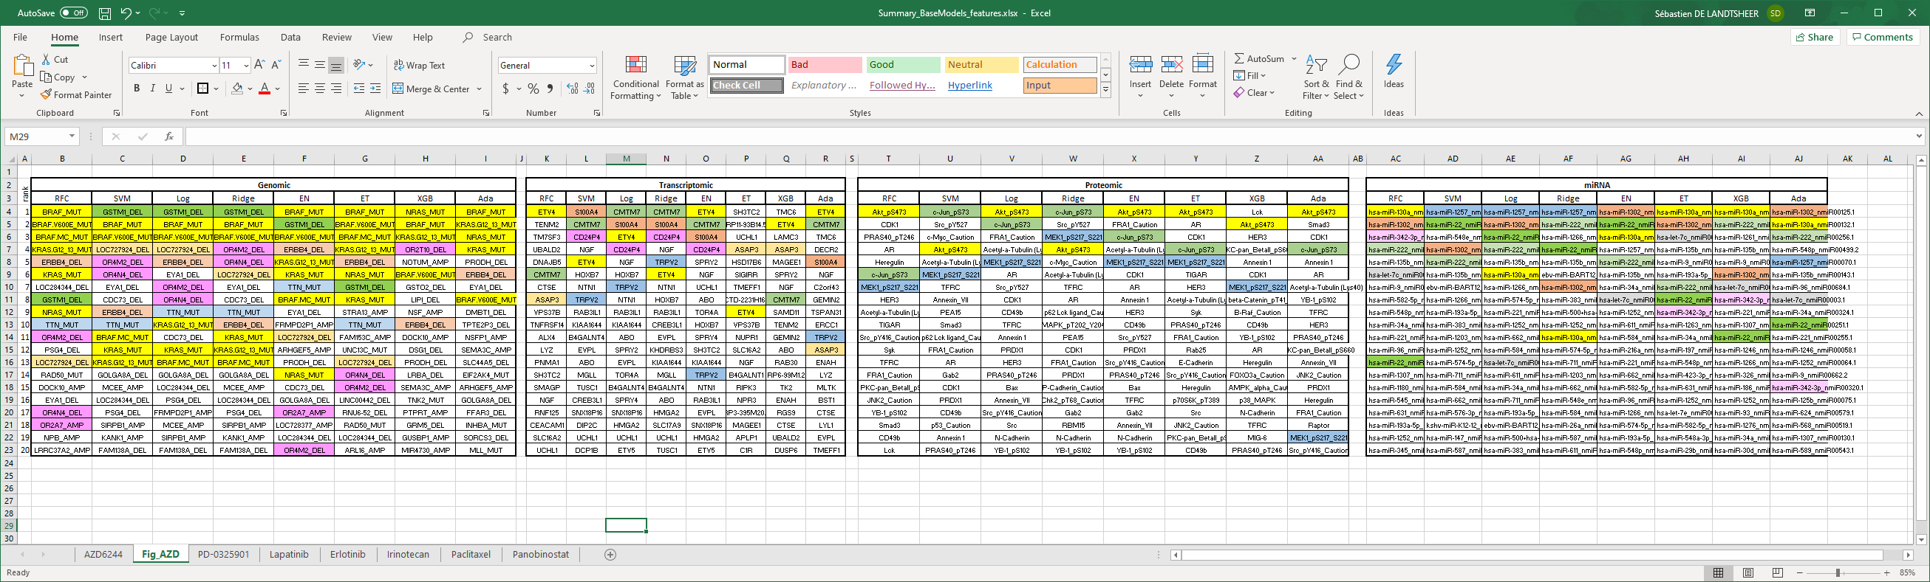
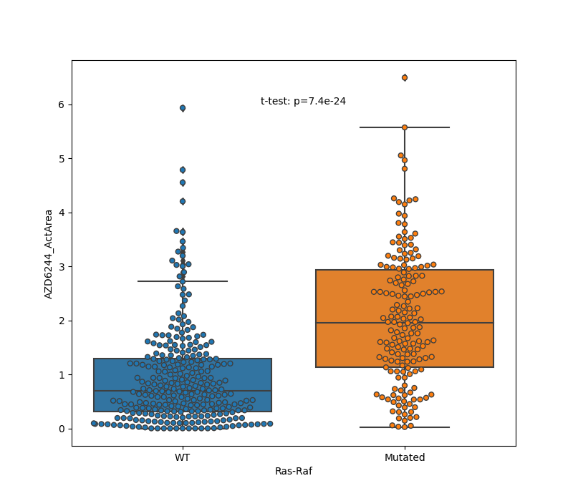
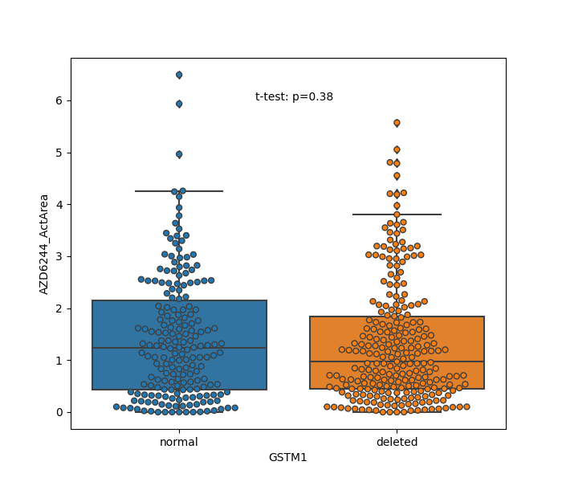
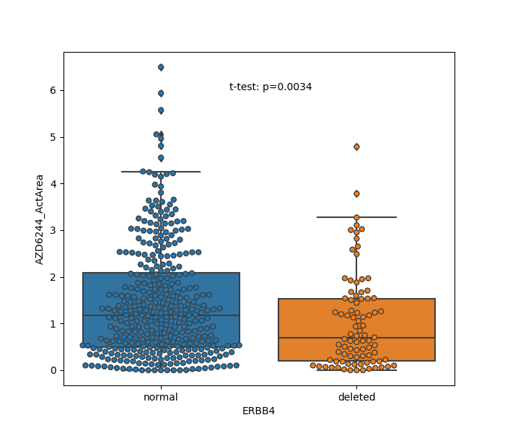
Model analysis points to specific markers of sensitivity 1: Selumetinib (MEK inhibitor), Genomics

Slide 16
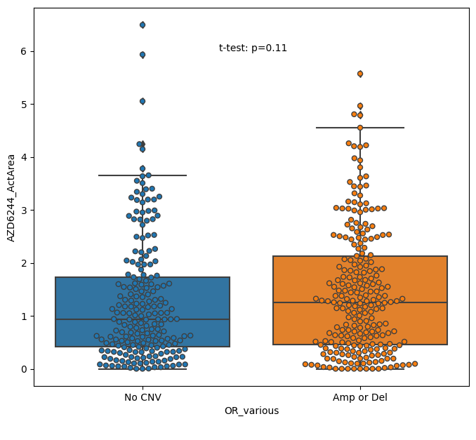
Model analysis points to specific markers of sensitivity 1: Selumetinib (MEK inhibitor), Olfactive Receptors?

Slide 17
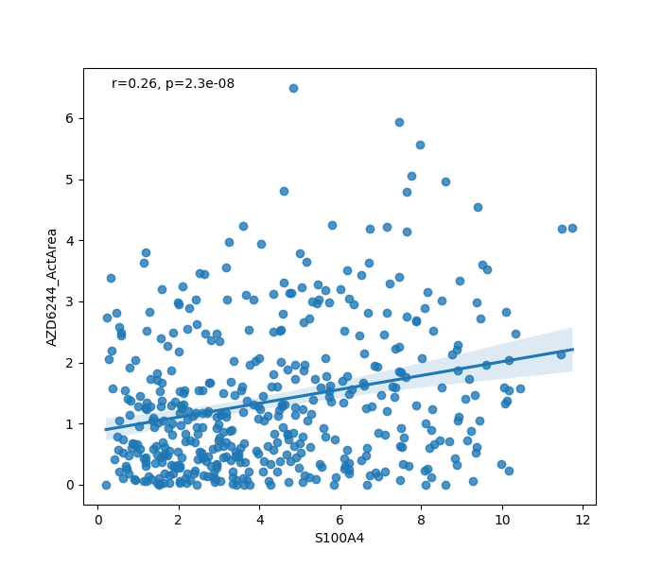
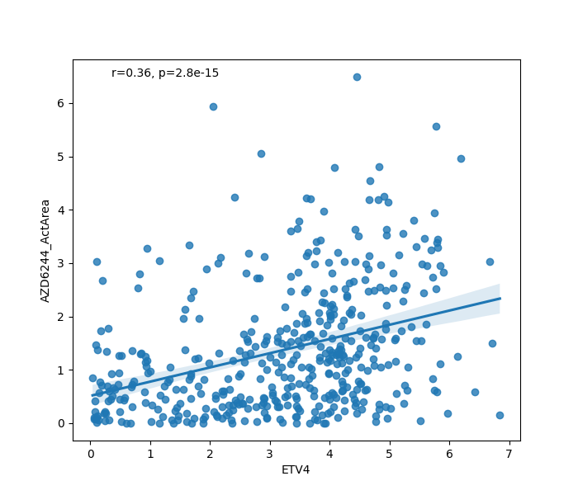
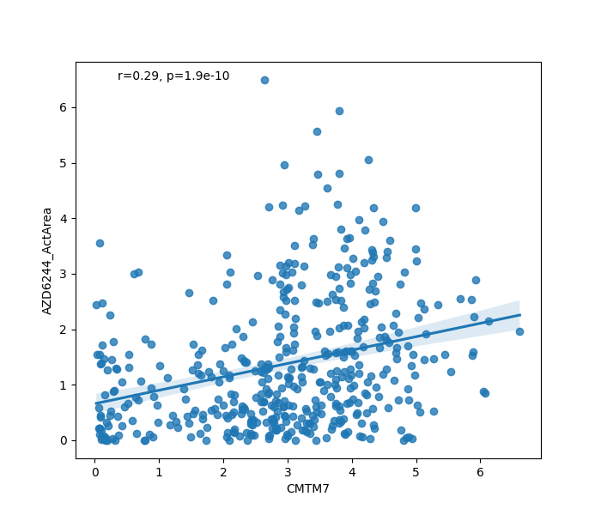
Model analysis points to specific markers of sensitivity 1: Selumetinib (MEK inhibitor), Transcriptomics

Slide 18
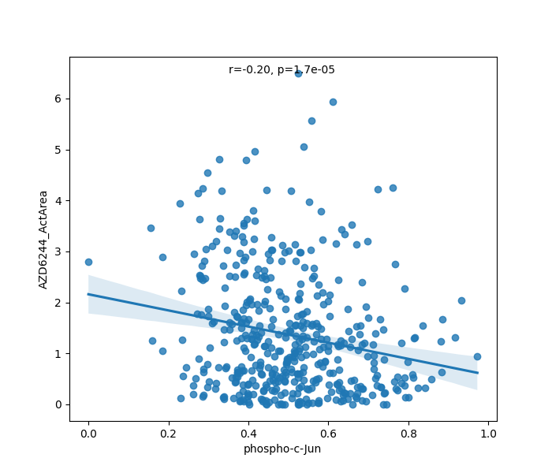
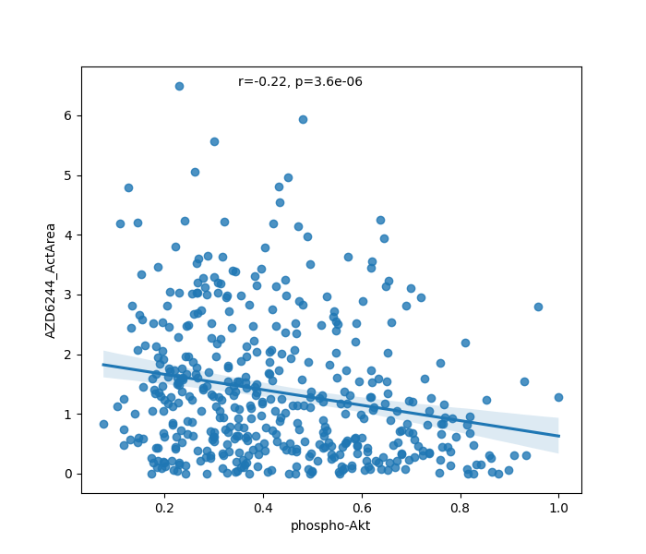
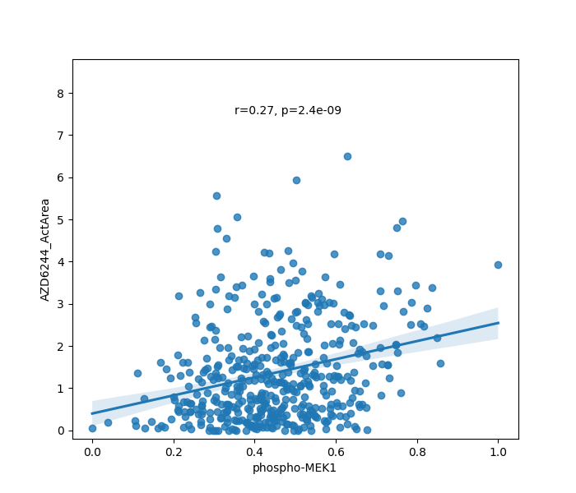
Model analysis points to specific markers of sensitivity 1: Selumetinib (MEK inhibitor), Proteomics

Slide 19
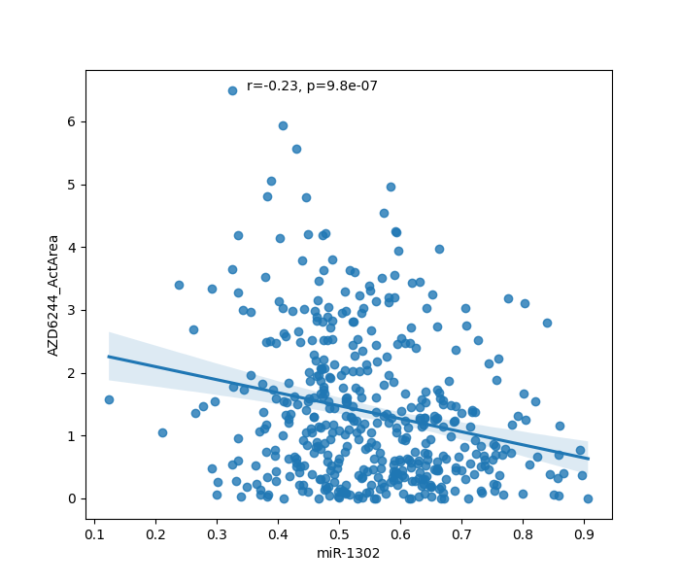
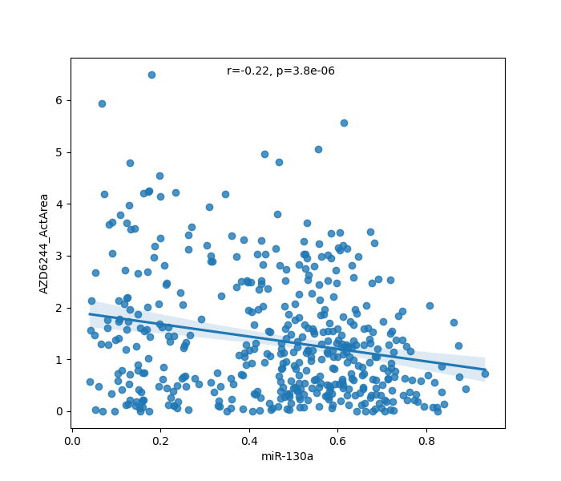
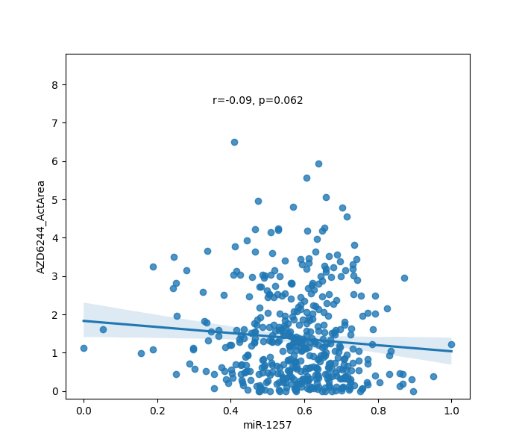
Model analysis points to specific markers of sensitivity 1: Selumetinib (MEK inhibitor), miRNAs

Slide 20
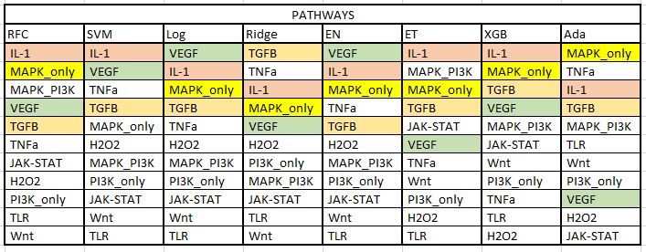
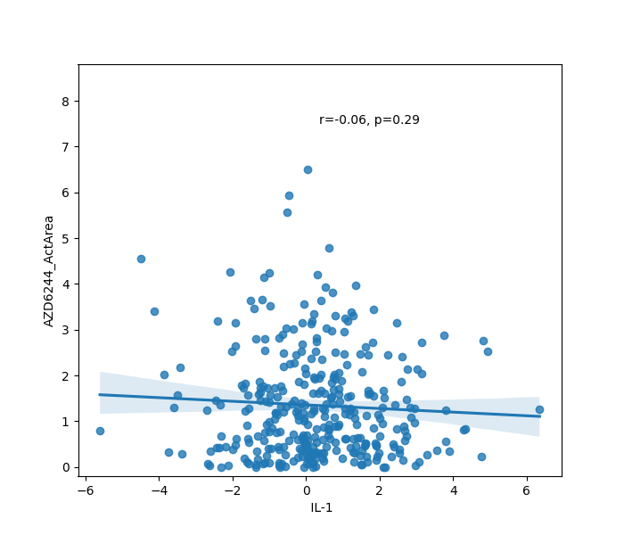
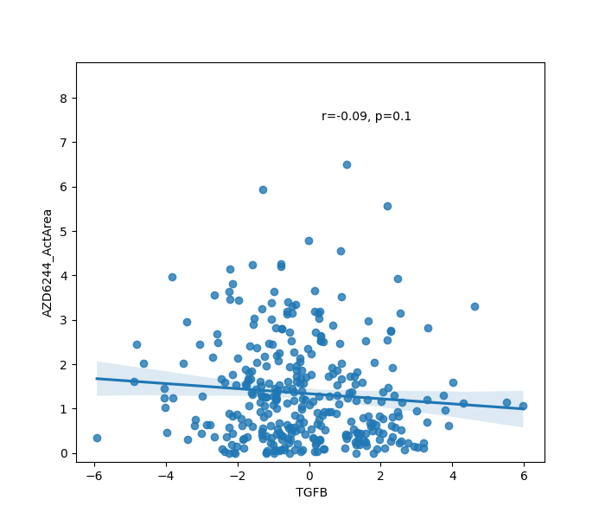
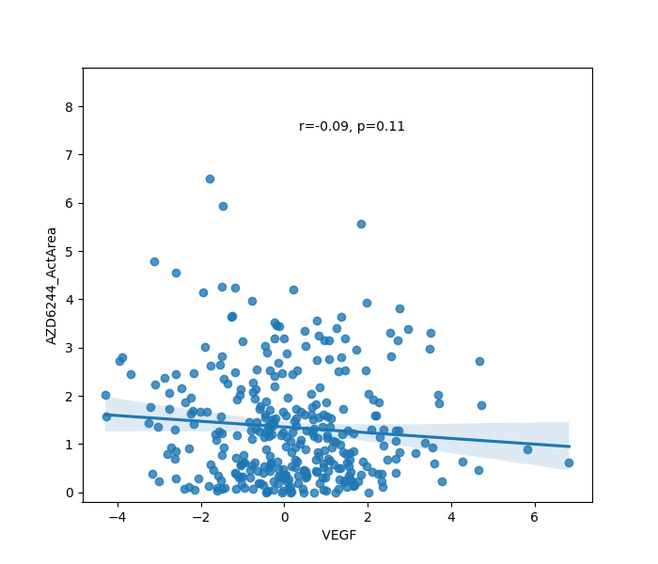
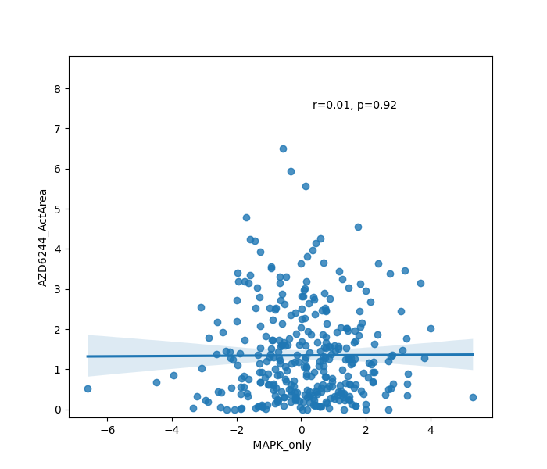
Model analysis points to specific markers of sensitivity 1: Selumetinib (MEK inhibitor), Pathway Activity

Slide 21


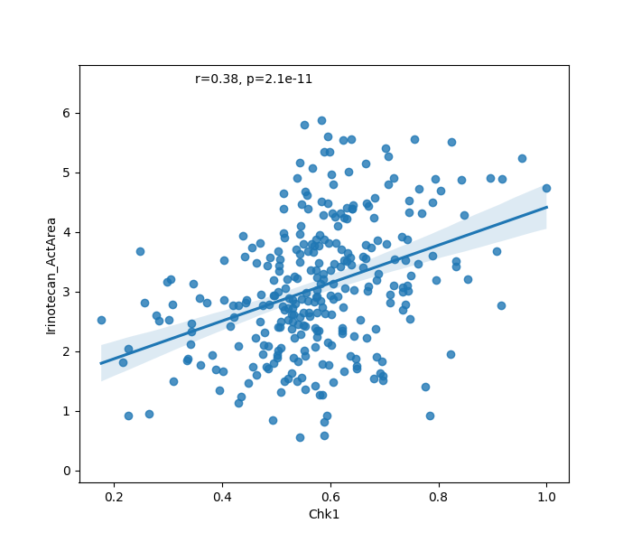
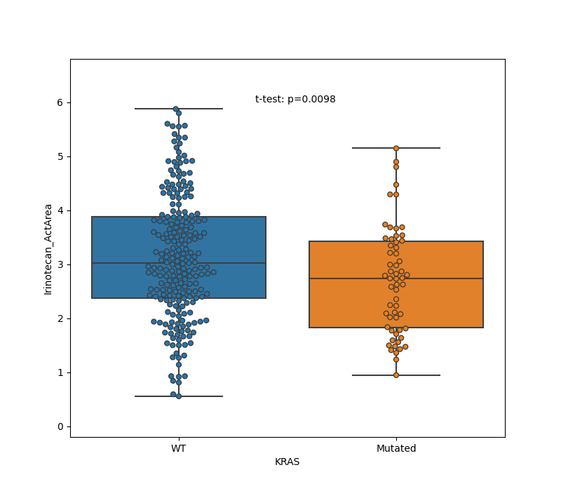

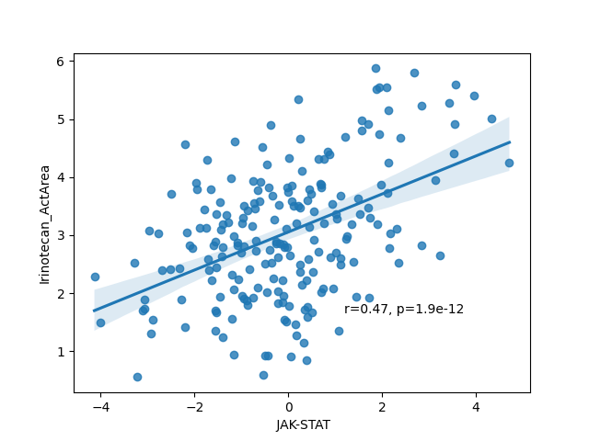
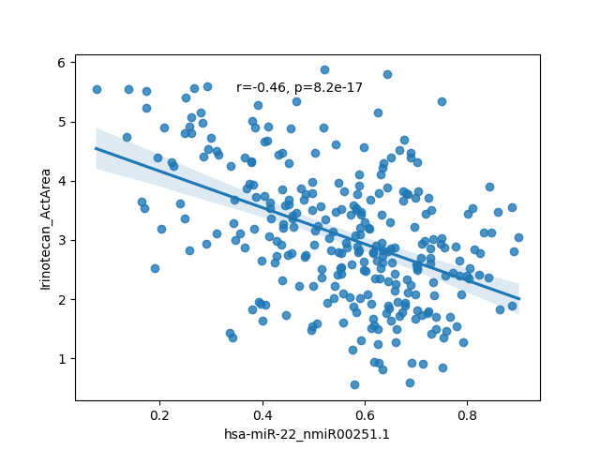
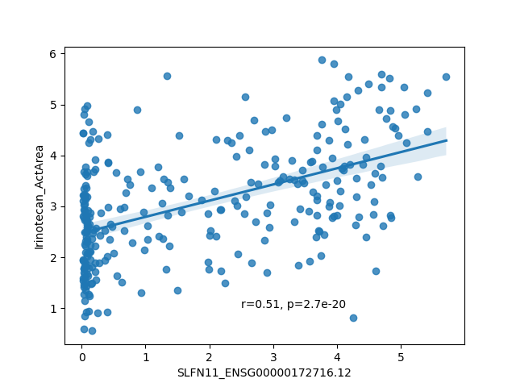
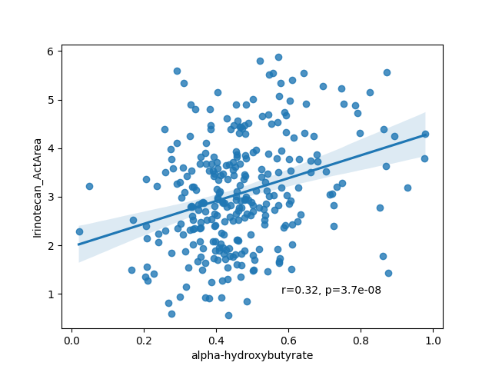
Model analysis points to specific markers of sensitivity 2: Irinotecan (Topoisomerase I inhibitor)

Slide 22
What if we had only transcriptomics?

Slide 23




Conclusions and perspectives
Performance of predictors of sensitivity:
High (75% - 87% ROCAUC): 7 drugs
Intermediate (65% - 75% ROCAUC): 8 drugs
Low (<65% ROCAUC): 8 drugs
Transcriptomics has the largest predictivity
High accuracy for specific cancer types
Models point to both known and putative novel markers and/or targets
=> deeper analysis to lead to fully interpretable models
=> experimental validation: causality of markers
=> clinical evaluation on patient data (organoids)

Slide 24
THANK YOU FOR YOUR ATTENTION

Slide 25
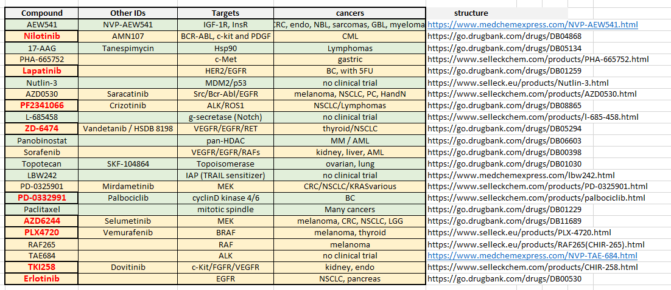
Conclusions and perspectives

